Slide 1
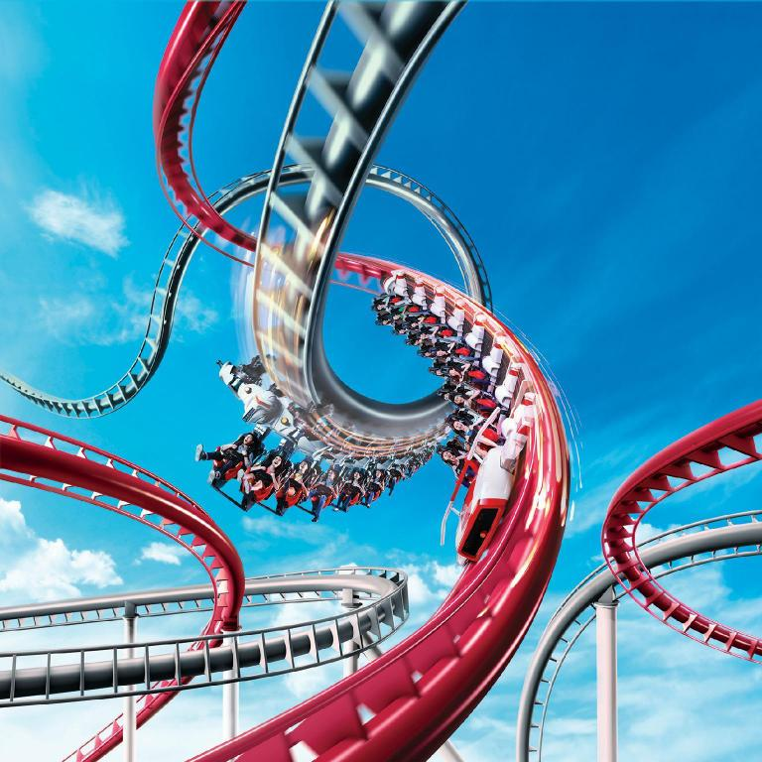
Group 5 presents…
Your Ultimate Survival Kit to Universal Studio Singapore
Chiu Shih-Cheng, Fong Bao Xian, Loh Jiahui, Neo Yixin, Shi Kaiyue, Zhu Yiting
Notes:
The presentation should be supplemented with slides and a brief demonstration of the workbook to highlight the solution to the problem is needed.

Slide 2




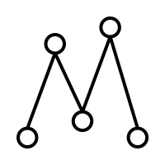

Objective, Influence diagram and Blackbox model
Model Overview
Demonstration
Sensitivity Analysis

Slide 3
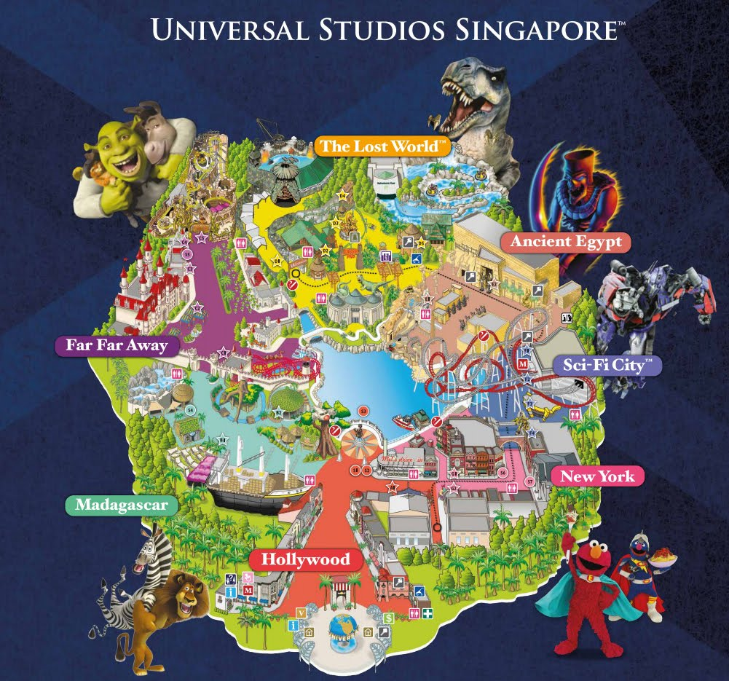
Recap Objectives
Ride waiting time has significant impact on theme park satisfaction
Longer waiting time at USS post-COVID-19
Personalised planner to minimise waiting time for visit

Slide 4
Influence Diagram
Day of visit
Duration of ride
End time at ride
Arrival time at USS
Start time at ride
Wait time per ride
Total wait time
Departure time from USS
Lunch time
Total wait time + travel time
Arrival time at ride
Preferred itinerary type
Total travel time
Travel time between rides
Change in visitorship
Distance from entrance
Parameters
Decisions
Preferred attractions
Inter-ride distance
Walking pace
Performance Measure
Consequence Variable
Notes:
Removed weather
Removed shopping
Add visitor numbers as parameters for influence model
Changed duration of ride to parameters

Slide 5
Blackbox Model
Decisions
Blackbox
Performance Measure
Arrival time at ride
Total wait time + travel time
Parameters
Consequence Variables
Day of visit
Arrival time at USS
Departure time from USS
Lunch time
Preferred itinerary type
Change in visitorship
Preferred attractions
Duration of ride
Walking pace
Wait time per ride
Distance from entrance
Inter-ride distance
Start time at ride
End time of ride
Travel time between rides
Total wait time
Total travel time

Slide 6
Which day?
Lunch?
Trade-off decisions made by users
Model
Arrival/ Departure Time
Schedule Preference
Walking Pace
Rides

Slide 7


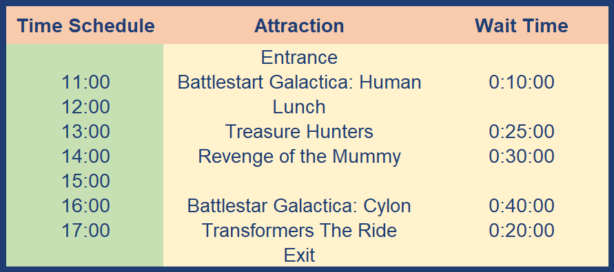
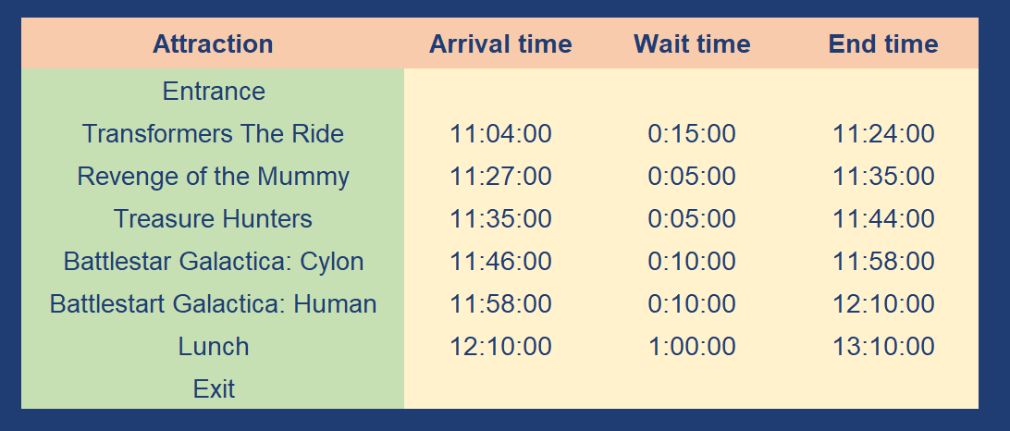
Because two is better than one
Model 1
AND
Model 2
Double solver
Constraints table
METHOD
Considers all possible ride permutations
SCHEDULE
Loose schedule
Timeslots blocked by the hour
OUTPUT
Tight schedule
Back-to-back ride timings

Slide 8
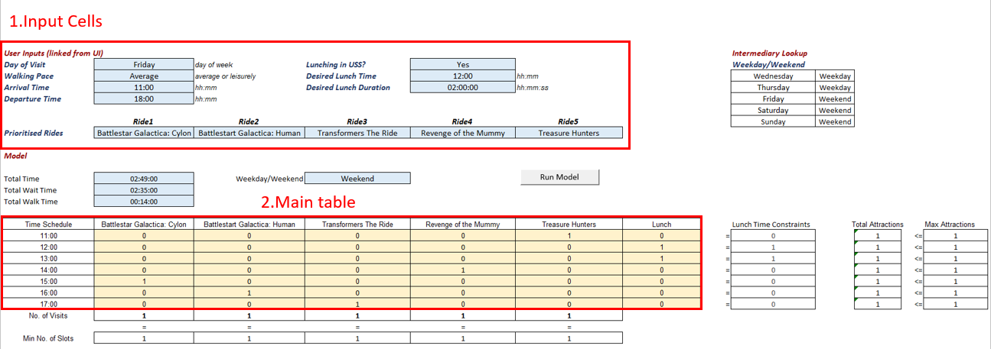
Model 1: Double Solver
Solver 1

Slide 9
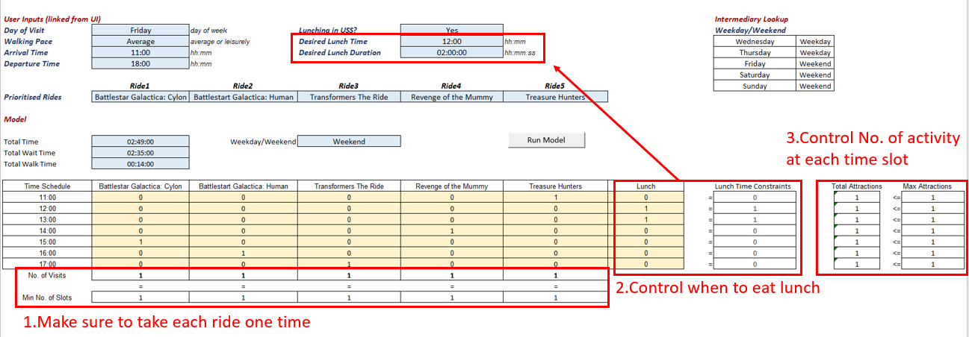
Model 1: Double Solver
Solver 1

Slide 10
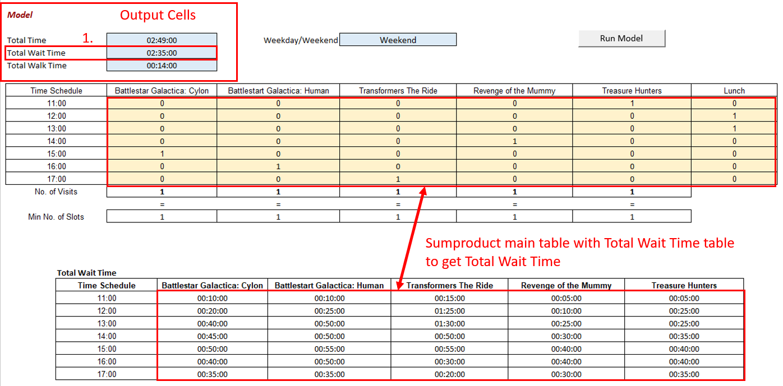
Model 1: Double Solver
Solver 1

Slide 11
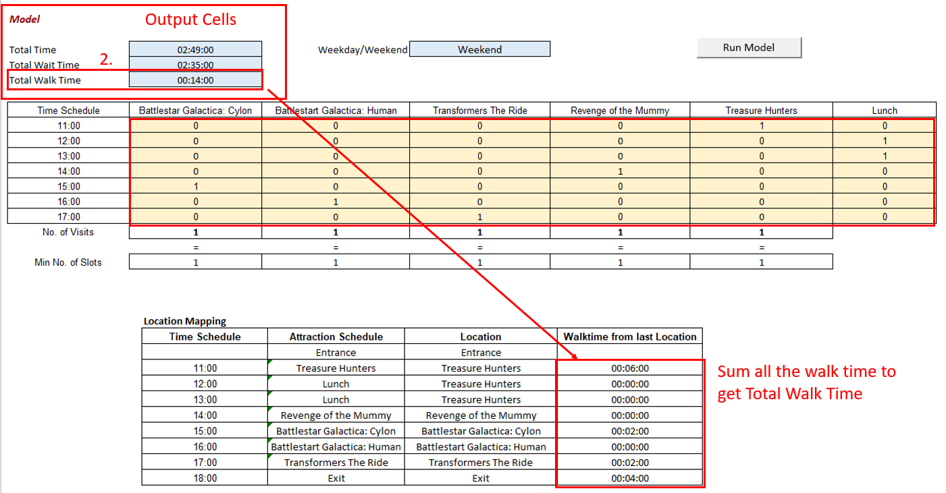
Model 1: Double Solver
Solver 1

Slide 12
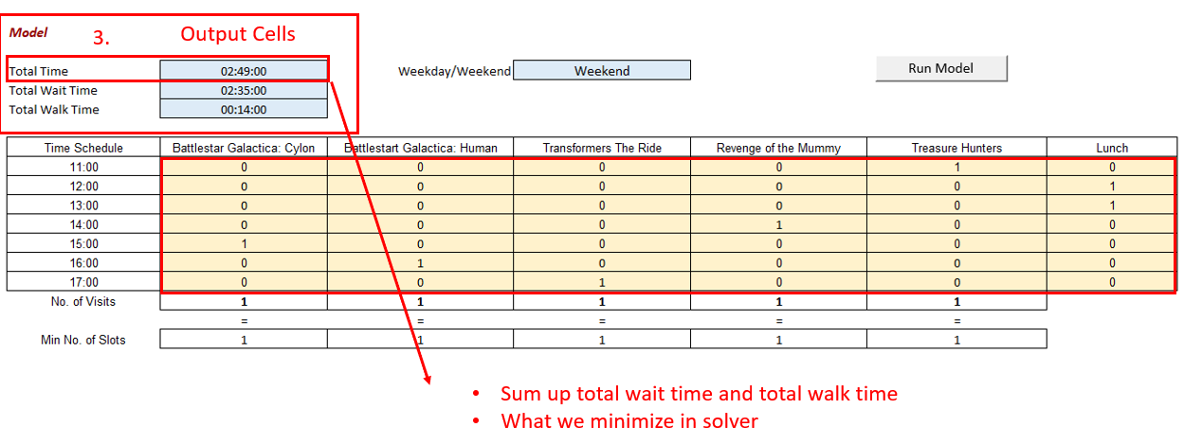
Model 1: Double Solver
Solver 1

Slide 13
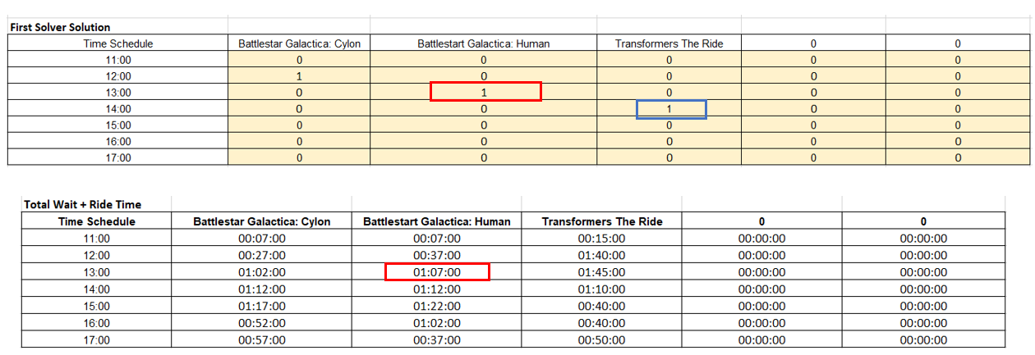
Model 1: Double Solver
Solver 2
If we only use the result of the first method, we may ignore the situation of a ride over 1 hour.
Thus, we need second solver.

Slide 14
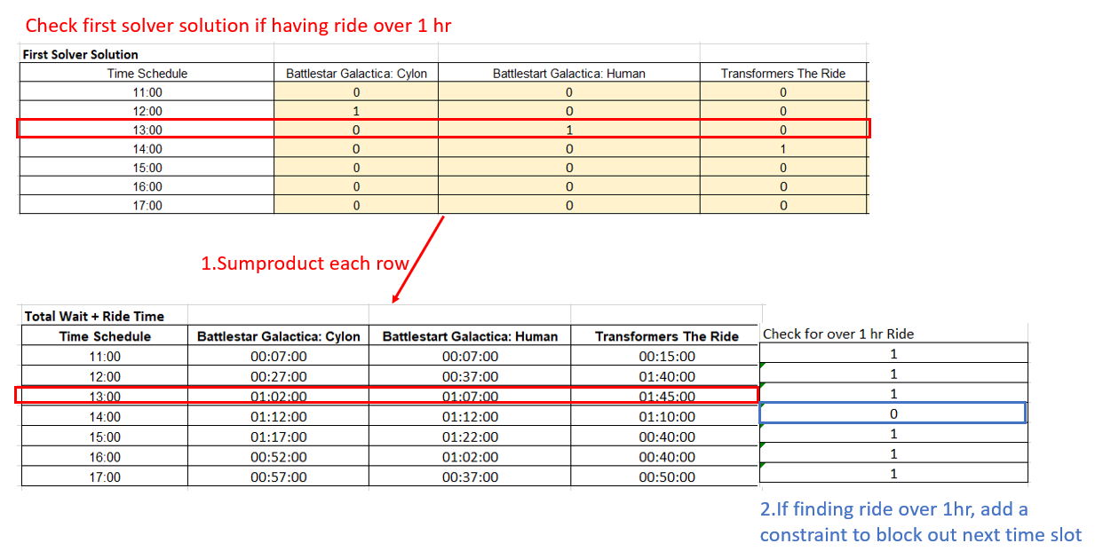
Model 1: Double Solver
Solver 2

Slide 15
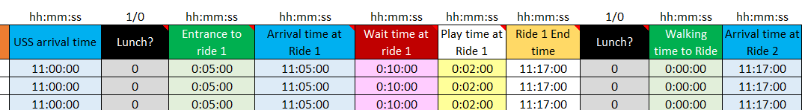
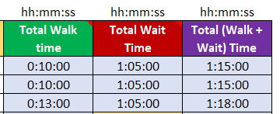

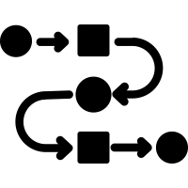

Model 2: All possible routes
Left to right computation
Chronological
Start from arrival time
Check and add
Lunch (once only)
Walk time from entrance to (R1)
Calculate arrival time (R1)
Wait-time (R1)
Play time (R1)
Calculate End time (R1)
Total walk & wait time
Display route with minimum time
Tie-Breaker Routes
Method similar to “Queuing model’ Exercise
Simultaneous checking and adding
At the current time , is it time for lunch? (1/0)
At the current location, Index – Match to retrieve the time needed to walk to next ride
Calculate actual time when we reach the next ride
Vlookup for ride 1 playtime
Calculate the new actual time when ride 1 ends, repeats…
Sum up walk and wait times to get Total (walk & wait) time
Index – Match to retrieve the wait time at that ride, at that time

Slide 16
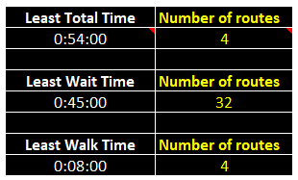
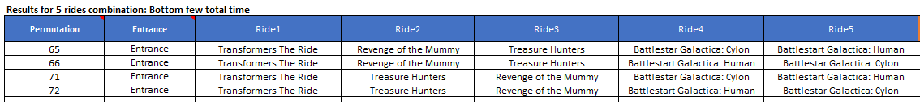
Model 2: All possible routes
First Schedule
Tie - Breaker Schedules

Slide 17
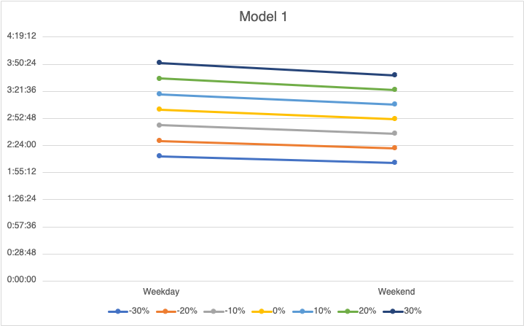
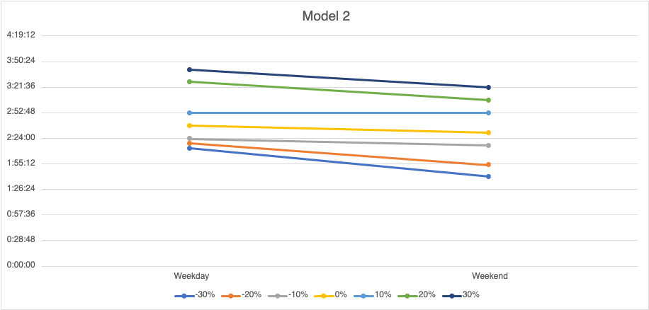
Sensitivity Analysis
Significant decline in visitor numbers and park capacity during Covid-19
International travels has improved in 2022 with reopening of economy and lifting of travel restrictions
How will this impact wait time?

Slide 18

Thank you!

Slide 19
Which do you prefer?
Model 1
VS
Model 2
Time spent in USS does not affect number of rides input
Tie –breaker route options are displayed (incomplete rides too)
For the same number of rides, the ‘total system time’ could be less
For people who prefers a general, flexible plan
Lunch time is accurate
PROS
Shorter duration in USS → input less number of rides inputs
Longer computational time
Back to back rides
Desired lunch time vs allocated lunch time can be very different
CONS

Slide 20
Model 1
Model 2
Attraction | Arrival time | Wait time | End time
Battlestar Galactica: Human | 11:05:00 | 0:10:00 | 11:17:00
Treasure Hunters | 11:19:00 | 0:05:00 | 11:28:00
Revenge of the Mummy | 11:28:00 | 0:05:00 | 11:36:00
Battlestar Galactica: Cylon | 11:38:00 | 0:10:00 | 11:50:00
Transformers The Ride | 11:52:00 | 0:15:00 | 12:12:00
Lunch | 12:12:00 | 1:00:00 | 13:12:00
Retrieve this route from Model 2

